Slide 1
Implementing DC-GAN

Slide 2
Model
Shared Parameter
x
D
real
y
z
G
D
gen
y

Slide 3
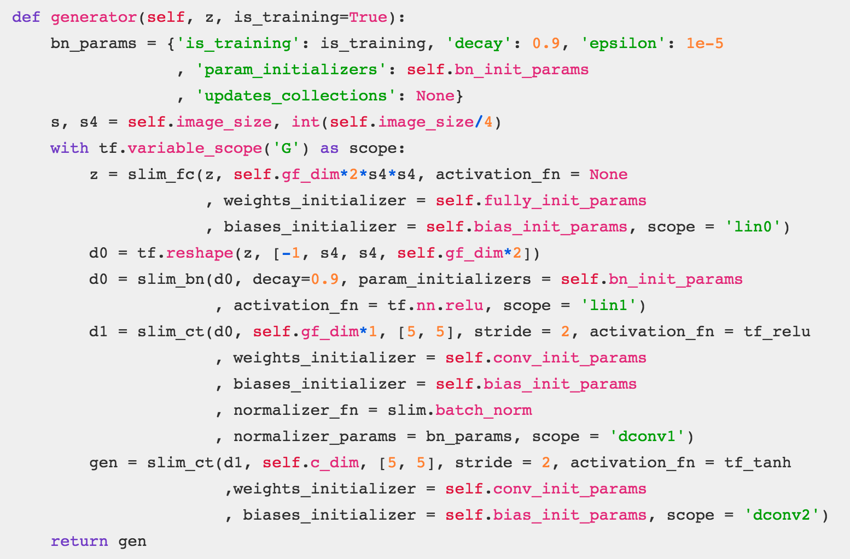
Generator

Slide 4
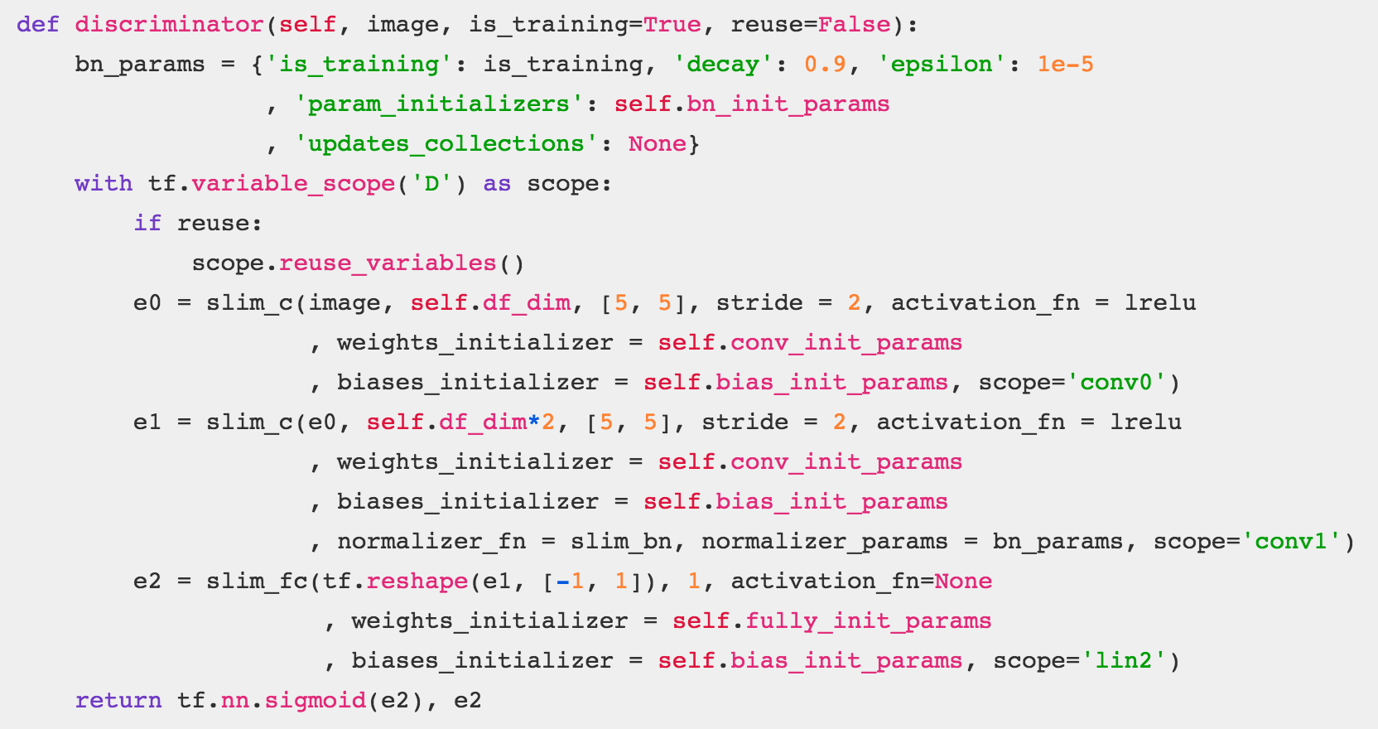
Discriminator

Slide 5
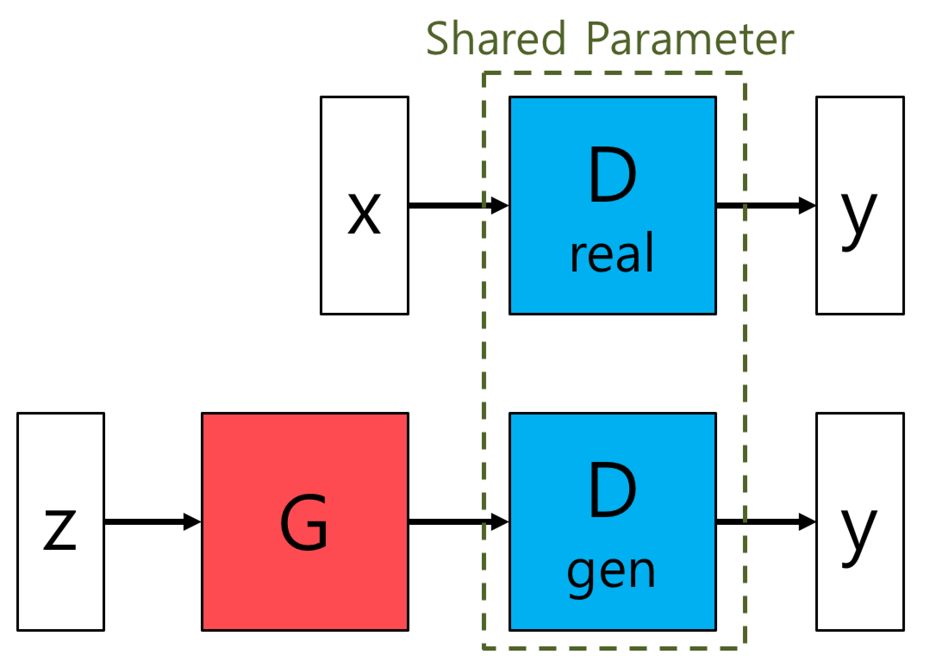
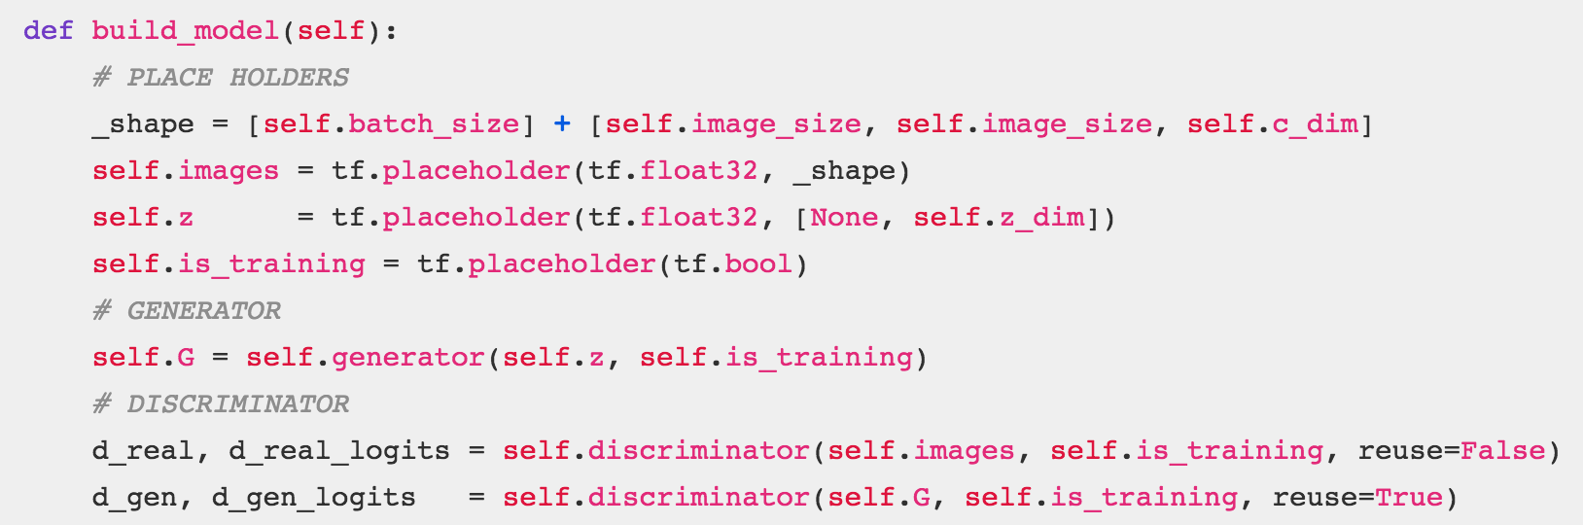
Model

